Slide 1
mining Internet of Things Data -healthcare
Beiyu Lin

Slide 2
Learning Objectives
Give a basic overview of data analytics in healthcare
Give a basic overview of data elements and their attributes
Describe the nine steps of the data analytics process

Slide 3
Benefits of healthcare data mining
Care providers can use data mining to identify effective treatments and best practices as well as to develop guidelines and standards of care;
Patients, especially those having chronic or high-risk diseases, can receive better, more affordable healthcare services with appropriate identification, tracking and use of appropriate interventions and treatment protocols;
Healthcare organizations can use data mining to improve patient satisfaction, to provide more patient-centered care, and to decrease costs and increase operating efficiency while maintaining high-quality care;
Insurance organization can detect medical insurance fraud and abuse through data mining and reduce their losses

Slide 4
How does data mining work in healthcare
The whole process includes the following main steps
Data selection: create a target data set from the original data
Data preprocessing: clean data to define strategies for handling missing data fields
Data transformation: reduce and project the data using transformation techniques or methods --- original data features from smart watches: accelemeter data (x,y,z) => derived features that are calculated from the original data: angle of movement; speed of moving; duration of moving
Data mining: extract interesting patterns (build and select models)
Data interpretation or evaluation: interpret and extract knowledge from the mined patterns

Slide 5
What is data mining in healthcare
Data mining provides the methodology and technology for healthcare organizations to:
evaluate treatment effectiveness,
save lives of patients using predictive medicine,
manage healthcare at different levels,
manage customer relationship,
detect waste, fraud and abuse.

Slide 6
Data Mining techniques in healthcare
healthcare data mining parameters include:
sequence or path analysis
(i.e. finding patterns where one event leads to another later event),
classification
(i.e. looking for new patterns and predicting variables based on the factors the database contains),
clustering
(i.e. grouping a set of objects and aggregating them based on their similarity to each other)
forecasting

Slide 7
Challenges for AI in Healthcare
Dataset shift
Accidental fitting of cofounders
Generalization to new populations
Unintended discriminatory bias
Susceptibility to adversarial attack or manipulation
Algorithmic interpretability is at an early stage but rapidly advancing
Notes:
https://bmcmedicine.biomedcentral.com/articles/10.1186/s12916-019-1426-2

Slide 8

Dataset shift
Particularly important for electronic health records (EHRs)
All input data are generated within a non-stationary environment with shifting patient populations, where clinical and operational practices evolve over time.
That is, the distributions in training and testing are different

Slide 9
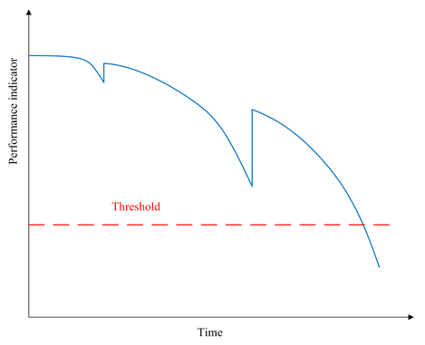

Solutions – dataset shift
Identify drift
Update models
How to know that we should update models?
Model performance

Slide 10
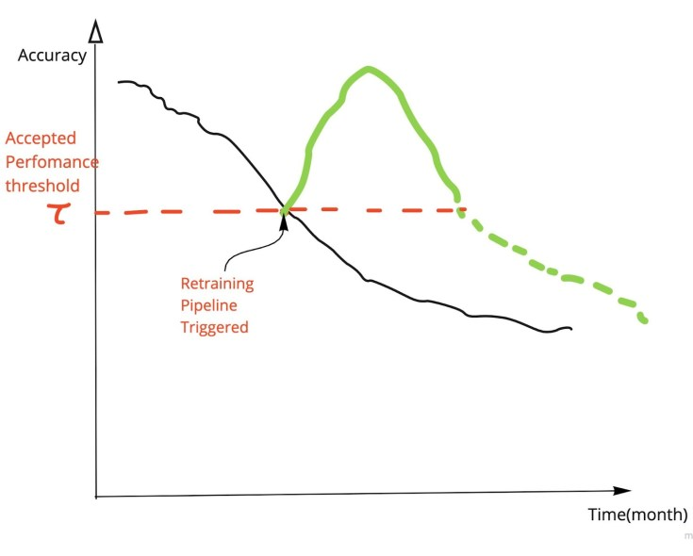
Solutions – dataset shift
Careful quantification of performance over time
identify problems
periodical retraining
Recommend the most appropriate updating method
from simple recalibration to full model retraining.

Slide 11
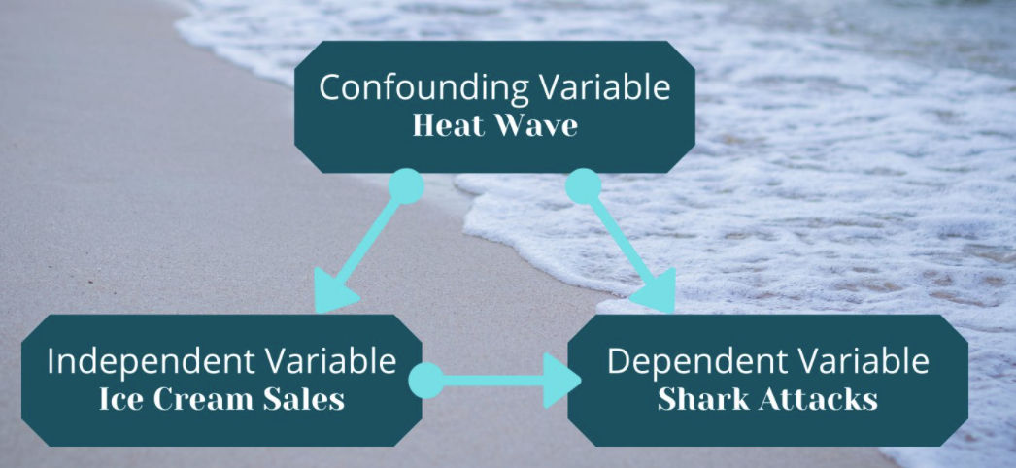
Accidentally fitting confounders v.s. true signal
Unreliable, unknown confounders are in the datasets
Impair the algorithm’s ability to generalize to new datasets
Notes:
did not learn the intrinsic difference between dogs and wolves,
but instead learned that wolves are usually pictured standing on snow, while dogs usually appear on wooden floor

Slide 12
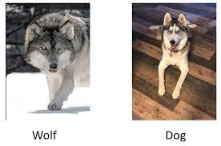

Accidentally fitting confounders v.s. true signal
Unreliable, unknown confounders are in the datasets
Impair the algorithm’s ability to generalize to new datasets
Example:
Notes:
did not learn the intrinsic difference between dogs and wolves,
but instead learned that wolves are usually pictured standing on snow, while dogs usually appear on wooden floor

Slide 13
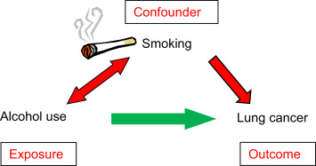
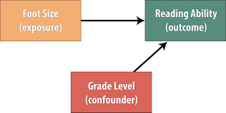
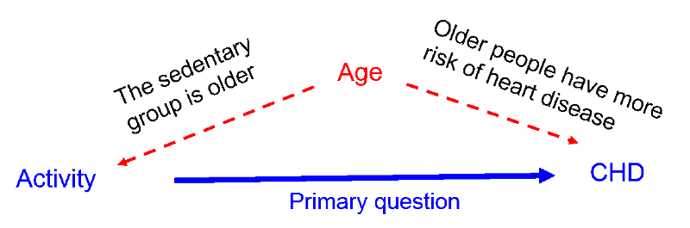
Accidentally fitting confounders v.s. true signal

Slide 14

Generalization to new populations and settings
Generalization can be hard due to technical differences between sites
Differences in equipment, coding definitions, EHR systems, and lab equipment
Variations in local clinical and administrative practices

Slide 15
Generalization to new populations and settings
How to overcome the challenges?
site-specific training to adapt an existing system for a new population
Design external validation
Testing and AI system using adequately sized datasets ( different from training data)

Slide 16
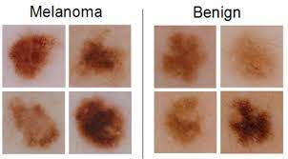
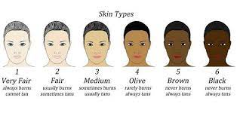
Algorithmic Bias
Biases => a risk of unintended / unknown accuracies in minorities subgroups
E.g., hospital mortality prediction algorithms with varying accuracy by ethnicity
Fair skin patients => skin of color
accuracy similar to that of board-certified dermatologists
Notes:
Melody – no – ma
banana – nine

Slide 17
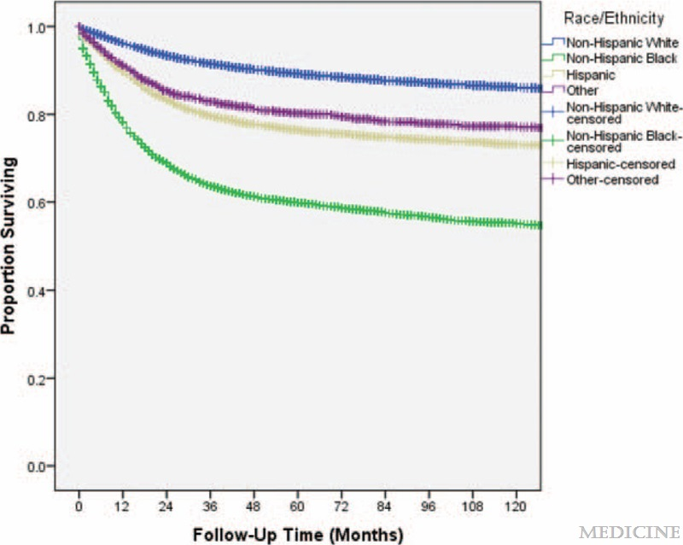
Algorithmic Bias
Patients with skin of color with more advanced dermatological diseases
Have lower survival rates than those with fair skin
Notes:
Melody – no – ma
banana – nine

Slide 18
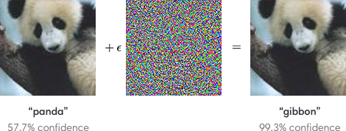
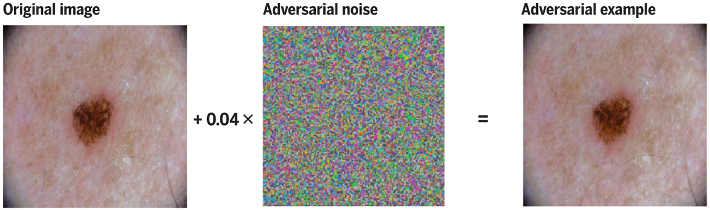
Susceptibility to adversarial attack or manipulation
What is adversarial attack?
To fool
benign
malignant
Notes:
Get-笨
Malignant (muh-lid-g-nit)

Slide 19
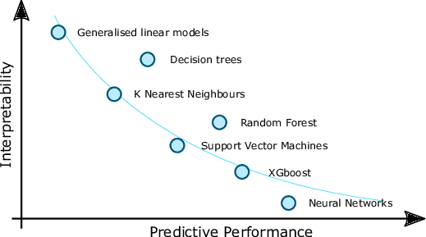
Algorithmic interpretability
Trade of between performance and explainability

Slide 20
Course PRojects
Five topics:
1. smart environment
2. smart health
3. transportation
4. agriculture and climate
5. sports and other industry

